Slide 1

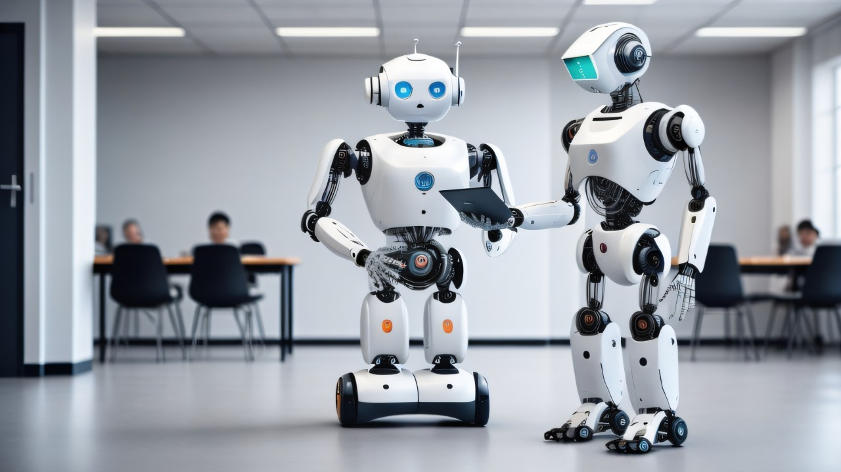
Name of the School: School of Computer Science and Engineering
Course Code: E2UC201C Course Name: OOPS
MOVIE TICKET BOOKING SYSTEM
Admission No: 23SCSE1012672
Name: SHAURYA SINGH
Section: 52

Slide 2
Name of the School: School of Computer Science and Engineering
Course Code: E2UC201C Course Name: OOPS
Problem Statement
In modern era, to booking movie tickets involved physically going to a specific theater, standing in queues, and purchasing tickets. This process can be time-consuming and inconvenient for customers. To address this issue, we aim to create an ”online movie ticket booking system” that streamlines the process and provides a more efficient way for users to book tickets.
Project Objectives:
Real-Life Understanding: Develop an online platform that mimics the process of booking movie tickets.
Automation: Enable users to book tickets online, eliminating the need to visit theaters in person.
Efficiency: Provide enhanced techniques for maintaining up-to-date information, resulting in a more efficient system.
Then Solution: Our system will allow users to perform the following actions:-
Movie Details: Access movie trailers, images, and other relevant information.
View Movies: Users can see a list of available movies across various theaters.
Show Timings: Check show timings for each movie.
Ticket Booking: Book tickets for specific shows through online.

Slide 3
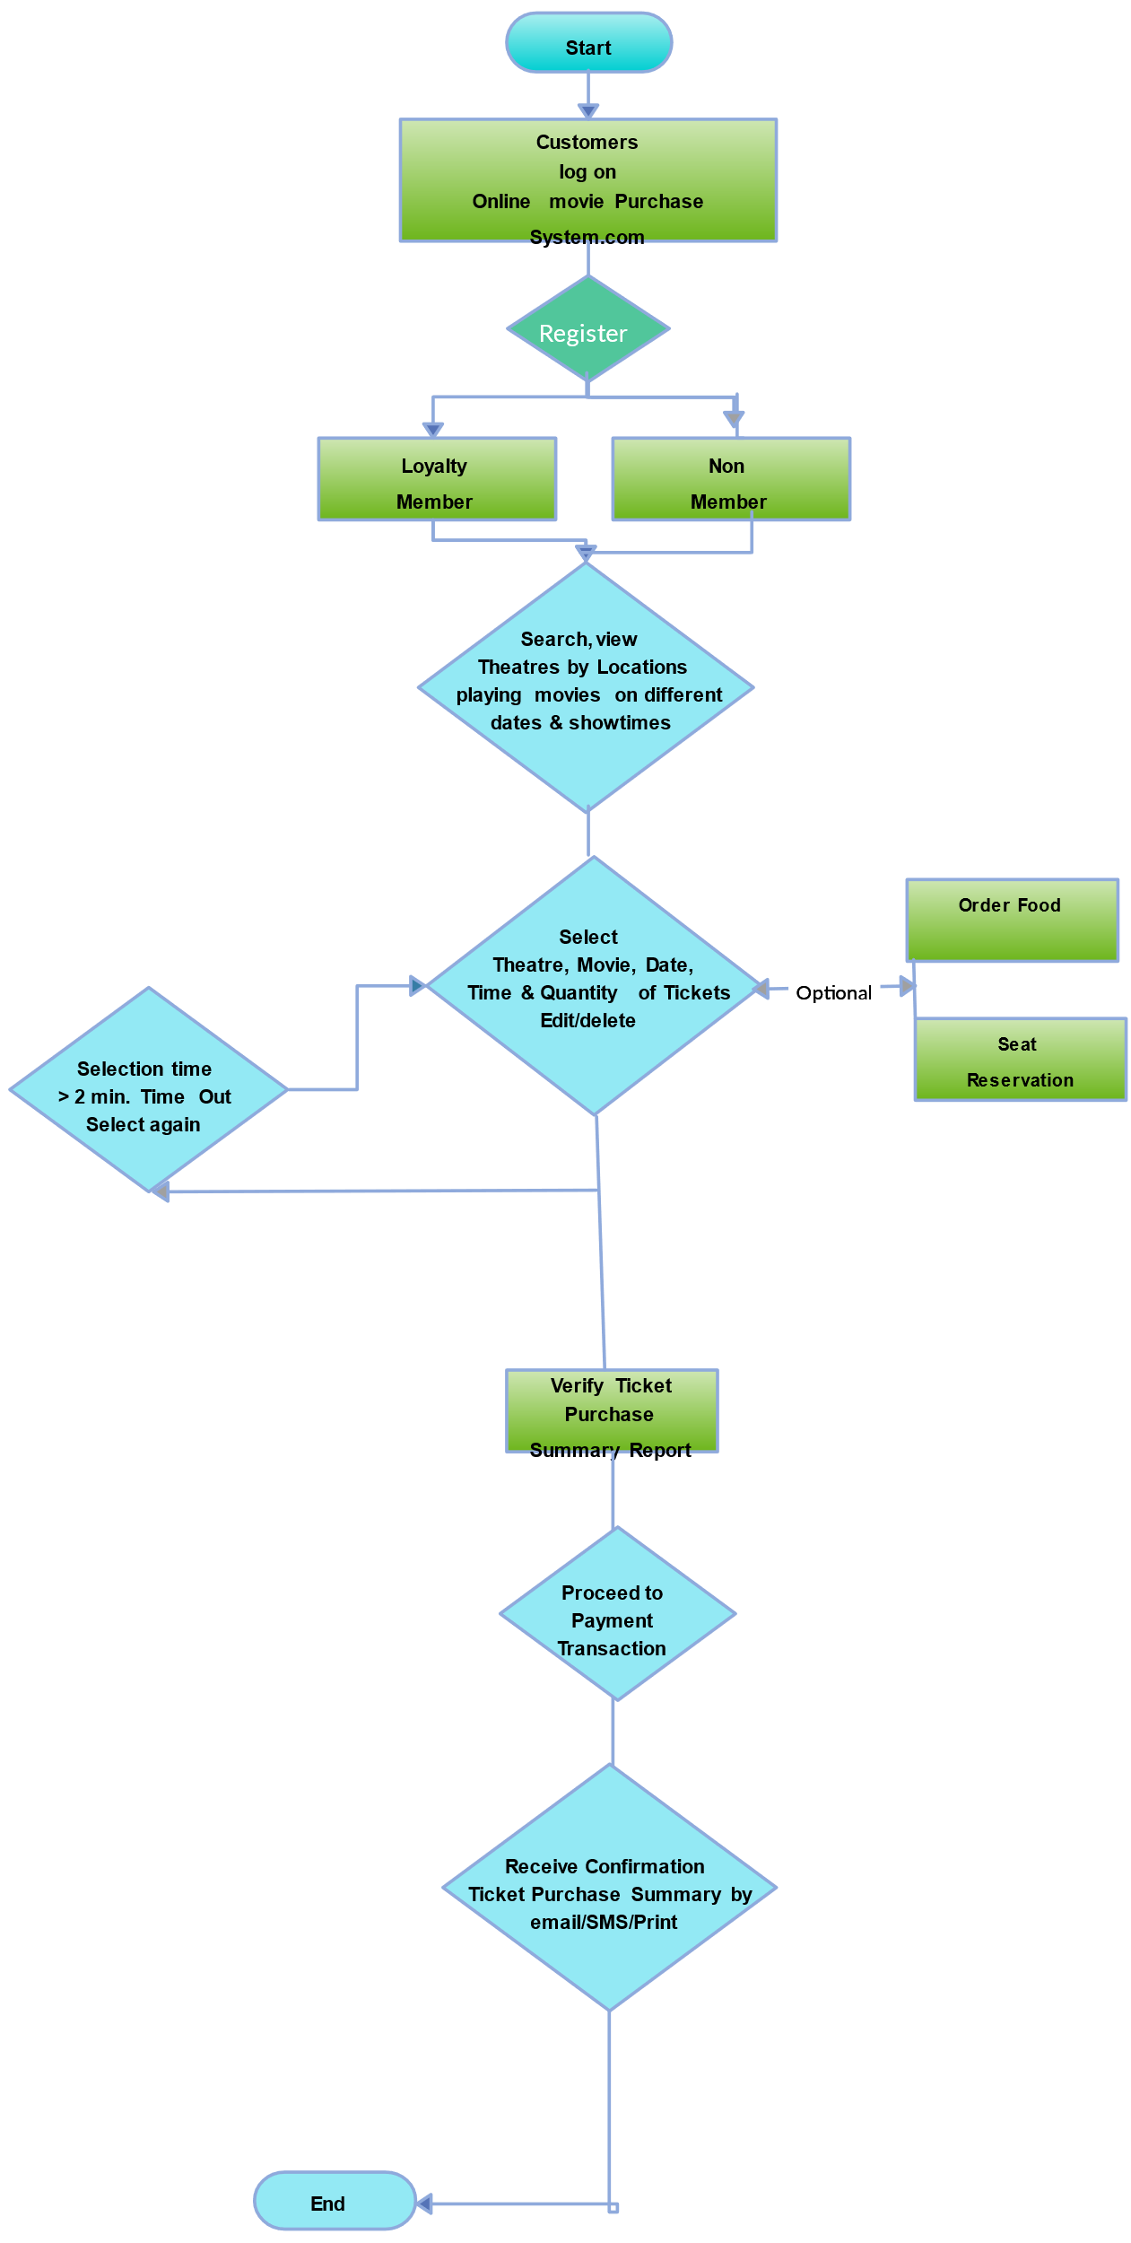
Name of the School: School of Computer Science and Engineering
Course Code: E2UC201C Course Name: OOPS
Flowchart

Slide 4

Name of the School: School of Computer Science and Engineering
Course Code: E2UC201C Course Name: OOPS
Technology Used
Django is a high-level Python web framework that encourages rapid development and clean, pragmatic design. Built by experienced developers, it takes care of much of the hassle of web development, so you can focus on writing your app without needing to reinvent the wheel. It’s free and open source. In this movie system we easy access all requirement to book movie like example movie name ,time, Date, Pvr’s etc.
Available Features:
Manager Panel
Cashier Panel
Add Movies
Schedule Shows
View Booking Details
Alter Ticket Prices
Make Bookings
Seat Selections
These features change easily by Django method

Slide 5
Name of the School: School of Computer Science and Engineering
Course Code: E2UC201C Course Name: OOPS
Conclusion
NOW EASILY SEE MOVIES IN THREATRE
Simple Movie Ticket Pricing:
  Design a program that calculates the cost of a movie ticket based on the user’s age. If the user is under 3 years old, the ticket is free; if they are between 3 and 12, the ticket costs $10; and if they are Above 12, the ticket costs $15.
Online Movie Ticket Booking System:
  Create an online movie ticket booking system where users can search for movies in a given city, select a movie, choose a theater, pick a screen, and book tickets. The system should display available showtimes and allow users to reserve seats.
Movie Ticket Booking with GUI:
  Build a graphical user interface (GUI) application that allows users to browse available movies, select showtimes, and book tickets. Use libraries like Tkinter to create the interface.
Cloud-Based Movie Ticket Booking System:
  Develop a cloud-based movie ticket booking system that stores movie details, showtimes, and user bookings in a database. Users should be able to search for movies, select seats, and complete the booking process online.
THANK YOU

